Slide 1






Shipping Infectious Substances & Biological Specimens
Adopted from materials developed by the Sandia Laboratories

Slide 2
Learning outcomes
At the end of this topic, you should be able to:
Explain key terms used in shipping of infectious substances
Demonstrate packaging, marking and labelling of infectious
Demonstrate the filling of documents required for shipping of infectious substances

Slide 3
Content:
Definitions (Dangerous goods, infectious substances, cultures, biological specimens, genetically modified organisms, medical/clinical waste)
Classes of dangerous goods
Categories of infectious substances
Regulation of shipment of infection substances (regulatory agencies, rules, documentations, material transfer agreements, biosecurity regulations, UN Model Regulations)
Packaging of infectious substances (WHO recommendations)
Regulations that impact shipping process

Slide 4


Infectious Substance Transport
Transport – movement of biological material outside of a restricted area
Research labs
Sample transfers are necessary for study and to further research
Public health labs and diagnostic labs
Sample transfers are necessary for diagnosis and analysis
Transport can occur
Across international borders
Within a country
Within a facility
Slide 4
Notes:
Reasons for transportation of biological materials:

Slide 5
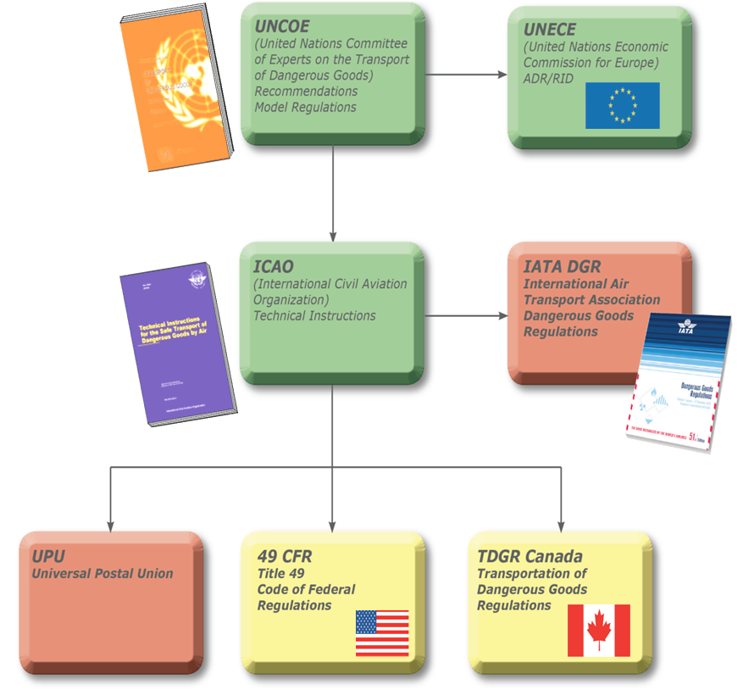
Shipping & Transport Regulations
International
Regional
National
Industry
Postal regulations
Mode requirements (Air, Road, Rail, Sea)
Carrier requirements
Import/Export
Slide 5
Notes:
There are many and varied agencies and interests that regulate the shipment of dangerous goods.

Slide 6

IATA Dangerous Goods Regulations
IATA – Represents, leads and serves the air industry
230 member airlines and air carriers (93% of intl. air traffic)
International standard – most air shipments will be inspected based on IATA requirements
Generally most restrictive
Incorporates all ICAO/UN requirements and most national regulations
ICAO- International Civil Aviation Organization
IATA – International Air Transport Association
http://www.iata.org/whatwedo/cargo/dangerous_goods
Slide 6
Notes:
Why IATA?
Most restrictive => most universal
“Gold” standard
Majority of air transport services are members
Compatible with UN/ICAO

Slide 7
Definitions from IATA
Dangerous Goods
Articles or substances which are capable of posing a risk to health, safety, property or the environment
Those goods which meet the criteria of one or more of the nine UN hazard classes
Slide 7
Notes:
General definition for dangerous goods:

Slide 8
9 Classes of Dangerous Goods
Class 1 Explosives
Class 2 Gases
Class 3 Flammable Liquids
Class 4 Flammable Solids
Class 5 Oxidizing substances and Organic Peroxide
Class 6 Substances affecting health
Class 7 Radioactive Material
Class 8 Corrosives
Class 9 Miscellaneous Dangerous Goods
6.1 Toxic Substances and
6.2 Infectious Substances
Slide 8
Notes:
Other substances that are occasionally shipped together with biological agents are also considered dangerous goods and require special considerations.
List some examples of other substances:

Slide 9

Definitions: Infectious Substance
Infectious substances are substances which are known or are reasonably expected to contain human or animal pathogens.
Slide 9
Notes:
IATA definition of infectious substance:
Infectious substances are substances which are known or are reasonably expected to contain human or animal pathogens.

Slide 10
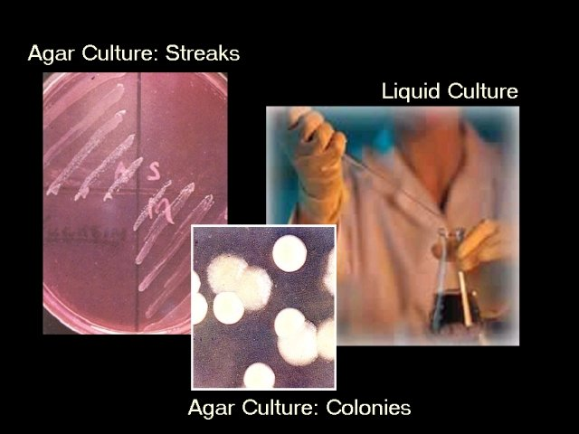
Definitions: Cultures
Cultures are the result of a process by which pathogens are intentionally grown.
Slide 10
Notes:
Define culture:

Slide 11
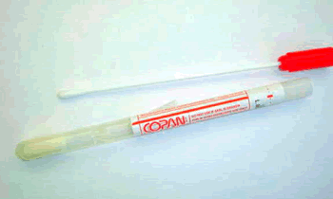
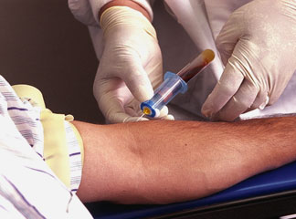
Definitions: Patient Specimens
Patient Specimens are those collected directly from humans or animals.
Examples include: blood, sputum, urine, tissue biopsy, swabs, and body parts.
Slide 11
Notes:
Define patient specimens:
List some examples of patient specimens:

Slide 12
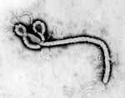
Definitions: Category A
Category A An infectious substance which is transported in a form that, when exposure to it occurs, is capable of causing permanent disability, life-threatening or fatal disease in otherwise healthy humans or animals
Slide 12
Notes:
Category A:
An infectious substance which is transported in a form that, when exposure to it occurs, is capable of causing permanent disability, life-threatening or fatal disease in otherwise healthy humans or animals.
List some examples of Category A substances:

Slide 13
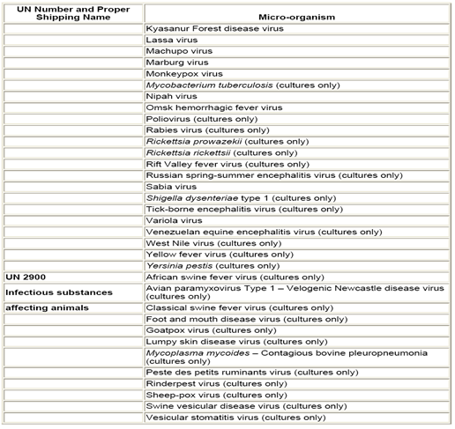
Definitions: Category B
Category B An infectious substance which does not meet the criteria for inclusion in Category A
Slide 13
Notes:
Category B:
Consists of all the non-deadly pathogenic agents; the low to medium risk infectious substances.
List some examples of substances that would be considered Category B:

Slide 14
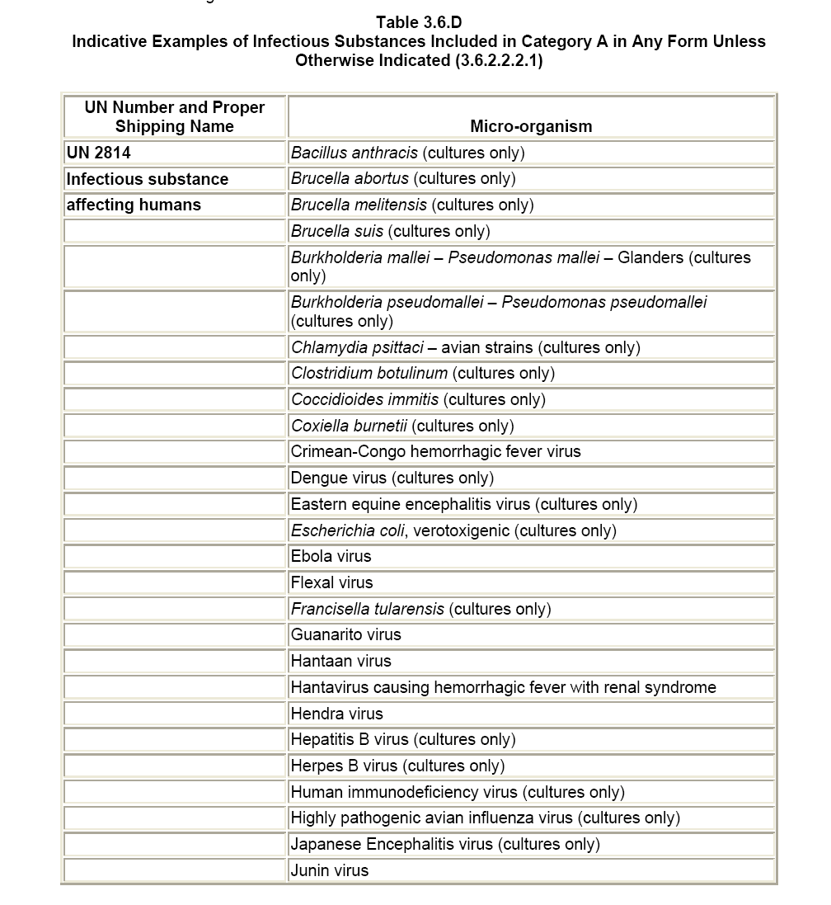
Examples: Category A Infectious Substances
Table lists examples and is not exhaustive
New or emerging pathogens meeting the same criteria should be classified as Category A
Cultures may be Category A or B depending on the microorganism
Slide 14
Notes:
What if you know or expect a pathogen to be present in the sample but you have little idea which pathogen?”

Slide 15
Definitions: Exempt Patient Specimens
Patient specimens for which there is minimal likelihood that pathogens are present are not subject to these Regulations if the specimen is transported in packaging that will prevent any leakage and which is marked with the words "Exempt human specimen” or “Exempt animal specimen”
Note: In determining whether a patient specimen has minimal likelihood . . . an element of professional judgment is required . . . that judgment should be based on:
known medical history
symptoms
individual circumstances
endemic local conditions
Slide 15
Notes:
Requirements for “Exempt human specimen” or “Exempt animal specimen”:
S
D
F

Slide 16

Anthrax Bioterrorism Scenario
A letter containing a terror threat and a mysterious white powder is opened at the Ministry of Defense office building
Slide 16
Notes:
Record significant observations:

Slide 17

Anthrax Bioterrorism Scenario
Nasopharyngeal swabs are collected from potentially exposed office workers
The swabs will be transported to local clinical laboratory for analysis
Are they infectious substances?
Would you classify these as Category A or B?
Slide 17
Notes:
Record significant observations:

Slide 18
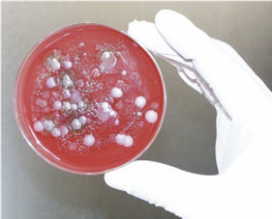
Anthrax Bioterrorism Scenario
The clinical lab cultures the swabs and determines that several colonies from three individuals appear to be Bacillus anthracis
These are sub-cultured and agar stabs are prepared for shipment to Central lab for verification
How do you classify these cultures (Category A or B)?
Slide 18
Notes:
How do you classify these cultures?
Is the risk different between the clinical specimen and the culture?

Slide 19
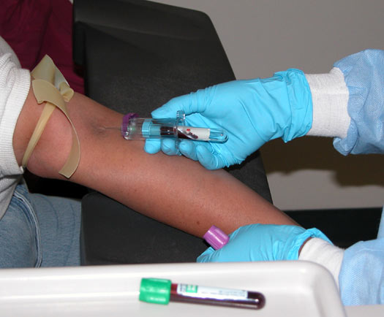
HIV Scenario
Blood is collected from a patient with AIDS in order to determine HIV viral load
Is this sample an infectious substance?
Is HIV on the Indicative list? Is this a culture or patient specimen?
How would you classify this test tube of blood (Category A or B)?
Slide 19
Notes:
Is the collected blood sample an infectious substance?
Is HIV on the Indicative list? Is this a culture or patient specimen?
How would you classify this test tube of blood?

Slide 20

Gonorrhea Scenario
Patient presents with symptoms of gonorrhea
Urine is collected and sent to lab for culture.
Is this an infectious substance?
Is Neisseria gonorrhoeae on the Indicative list?
How would you classify this urine (Category A or B)?
Slide 20
Notes:
Is the urine sample collected an infectious substance?
Is Neisseria gonorrhoeae on the Indicative list?
How would you classify this urine sample?

Slide 21
Definitions
Biological products
Those products derived from living organisms which are manufactured and distributed in accordance with the requirements of appropriate national authorities, which may have special licensing requirements, and are used either for prevention, treatment, or diagnosis of disease in humans or animals, or for development, experimental or investigational purposes related thereto.
Genetically modified microorganisms and organisms
Microorganisms and organisms in which genetic material has been purposely altered through genetic engineering in a way that does not occur naturally
Medical or clinical wastes
Wastes derived from the medical treatment of animals or humans or from bioresearch
Slide 21
Notes:
Note: more information and details on each of these 13 substances is provide in their workbooks. While they are discussing in their groups, create a 5x14 table on the flip chart with 13 substances listed in the left hand column and the classification options on the top row. Have each group come up to mark/tally their choices. Review the answers, pay special attention to those substances that have tallies in two classifications and ask similar questions to those that were asked in the first three scenarios “is it an infectious substance?” “Is on the indicative list?” “Is it a culture or patient specimen?” “Can the pathogen cause life threatening illness in otherwise health individuals?”,etc.

Slide 22
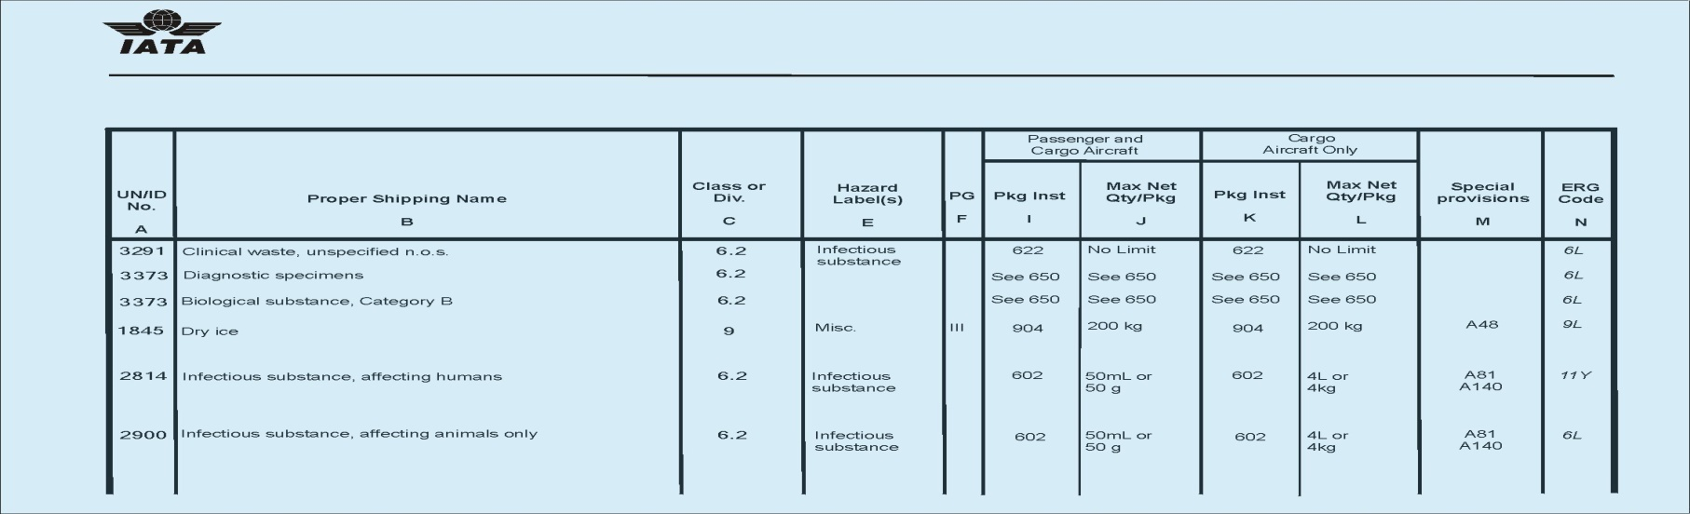
Proper Shipping Names & UN ID Numbers
Every dangerous good must be assigned a Proper Shipping Name (PSN)
The United Nations publishes a list of internationally standardized proper shipping names with corresponding four digit “UN” identification numbers
A dangerous good can have only one PSN
Slide 22
Notes:
Every dangerous good has one (and only one) PSN assigned by the shipper.
PSNs come from international agreement out of the UN and are in English.
Dangerous goods can be identified by both the PSN and/or the corresponding UN ID no.

Slide 23
Examples of Proper Shipping Names
Category A
UN 2814 – Infectious substance, affecting humans
UN 2900 – Infectious substance, affecting animals only
Category B
UN 3373 – Biological substance, Category B
Dry Ice
UN 1845 – Dry ice
UN 1845 – Carbon dioxide, solid
Exempt
Exempt human specimen
Exempt animal specimen
Slide 23
Notes:
Note key shipping names:
Category A
UN 2814-
UN 2900-
Category B
UN 3373-
UN 1845-

Slide 24
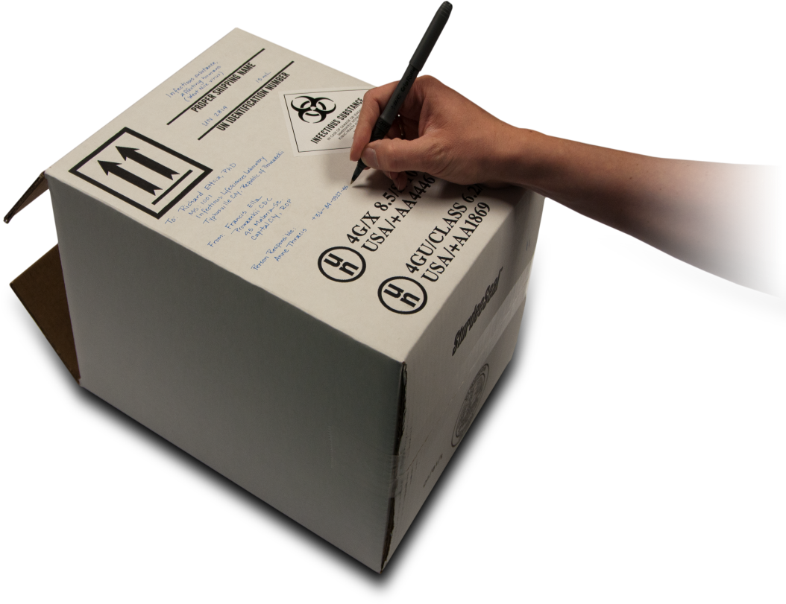
Mitigation Control Measures
Engineering Controls
Physical changes to work stations, equipment, materials, production facilities, or any other relevant aspect of the work environment that reduce or prevent exposure to hazards
Administrative Controls
Policies, standards and guidelines used to control risks
Practices and Procedures
Processes and activities that have been shown in practice to be effective in reducing risks
Personal Protective Equipment
Devices worn by the worker to protect against hazards in the laboratory
This measure is not applicable in shipping since the materials have left the laboratory
Slide 24
Notes:
Record review notes if necessary.

Slide 25

How we mitigate the risks associated with Shipping
Biorisk Mitigation
Actions and control measures that are put into place to reduce or eliminate the risks associated with biological agents and toxins
Engineering Controls
Packaging, marking/labeling, and documentation
Package security
Administrative Controls
Authorizing shipments
Material Transfer Agreements
Import and Export licenses
Carrier selection and requirements
Practices and Procedures
Training
Tracking of materials
Slide 25
Notes:
Record review notes if necessary.

Slide 26
Principles of Packaging
Must be designed to withstand damage and prevent leakage during transport
Must be labeled in a manner to alert carriers of hazards
Must have documentation to alert operators and emergency responders to hazards and allow for appropriate response in event of leakage/damage
Slide 26
Notes:
Note some observations of engineering controls:

Slide 27
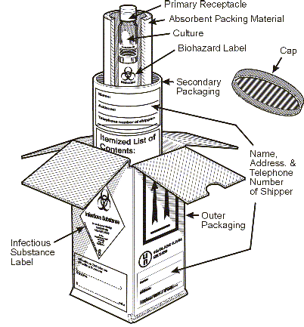
Overview of Packaging
Triple packaging required for Category A, B, and Exempt
Primary receptacle
A primary water-tight, leakproof receptacle containing the specimen
Secondary packaging
A durable, watertight, leakproof packaging to enclose and protect the primary receptacle(s)
Absorbent material shall be used to absorb all fluid in case of breakage
Outer packaging
Secondary packagings are placed in outer packagings with cushioning material
Outer packagings protect their contents from physical damage while in transit
At least one external surface with a minimum dimension of 10x10 cm
Slide 27
Notes:
Packaging Requirements:
Primary receptacle:
-
Secondary packaging:
-
-
Outer packaging:
-
-
-

Slide 28
Category A Packaging: IATA PI 620
Good condition
Leakproof primary
Leakproof secondary
Pressure capable primary or secondary
Absorbent (for liquids)
Multiple fragile primaries wrapped individually
Itemized list
Rigid outer packaging
4 in. minimum
Qty Limit 50 mL or 50 g for passenger aircraft. 4 L or 4 kg for cargo only aircraft
Name and telephone # marked on package
Must be marked with UN specification
U
N
4G/Class 6.2/2010
USA/+AA16324
Slide 28
Notes:
Category A key components

Slide 29
Category A Packaging
Slide 29
Notes:
The UN specification mark is an indication from the manufacturer of the packaging that the package has been tested and certified to these standards

Slide 30
Category B Packaging: IATA PI 650
Good quality
Leakproof/siftproof primary (1 L max)
Leakproof/siftproof secondary
Absorbent
Multiple fragile primaries wrapped individually
Pressure capable primary or secondary
Itemized list
Rigid outer packaging
Two sides at least 4 in.
Qty. less than 4L or 4kg
Name and telephone # marked on package or airwaybill
NO spec marks but 1.2ml drop
Slide 30
Notes:
Category B key requirments

Slide 31
Category B Packaging
Slide 31
Notes:
Note: “Diagnostic specimens” is no longer an acceptable proper shipping name and must be replaced with “Biological Substance, Category B”

Slide 32
Before a specimen is considered “Exempt”
Must be a patient specimen
Professional determination - minimal likelihood of pathogens
Must be triple packaged
Package marked “Exempt Human Specimen” or “Exempt Animal Specimen”
Slide 32
Notes:
“Exempt human specimens” are considered dangerous goods by IATA until they meet three criteria:
A professional determination has been made that the material has a “minimal likelihood” of containing any pathogens
They are tripled packaged as shown
The package is marked “exempt human specimens”

Slide 33

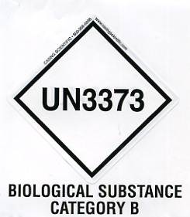


Marking & Labeling Overview
Markings provide information on
Contents of package
Nature of hazard
Applicable packaging standards
Must be clearly visible
Labels – two types
Hazard labels required for most dangerous goods
Diamond-shaped
Handling labels required for some dangerous goods
Various shapes
Affixed to outside of each package
Slide 33
Notes:
Marking provide information on
-
-
-
-
Labels
-Diamond-shaped
-Various shapes

Slide 34
Marking & Labeling
Addresses of shipper and consignee
Name and Phone number of person responsible
Applicable Hazard label for each dangerous good
Proper shipping name
UN Number
Quantity of (Category A and Dry Ice)
Slide 34
Notes:
There are the six required marks and labels associated with Class 6.2 dangerous good shipments and dry ice:
-
-
-
-
-
-

Slide 35



Proper Shipping Names and UN ID Numbers
The name must appear exactly (no abbreviation, no spelling errors, no extra information) on both the package and the paperwork
The UN ID number always is listed next to the name
From: Stan Sedgewick
ACME Labs
Aberdeen, WI 28471
Infectious Substances,
affecting humans
UN 2814
To: Eric Cook, MIT
77 Massachusetts Ave
Cambridge, MA 02139
10 ml
UN 1845
Dry ice
5kg
Slide 35
Notes:
PSNs with their associated UN Id. numbers appear next to the hazard label they are associated with.

Slide 36
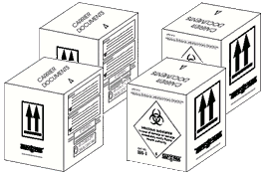
Shipping with Overpacks
Overpacks may contain one or more inner packages and may be used with Dry Ice
Each inner package must contain only the maximum quantity allowed under the List of Dangerous Goods
Overpacks must be marked & labeled exactly as the inner packages
The word OVERPACK must appear on the outside
50mL
From: ABC Labs
123 Main Street
Atlanta, GA 12345
Infectious substance,
affecting humans
UN 2814
To: XYZ Receiving
321 Center Ave
Boston, MA 54321
200mL
Person responsible Dr. Jane Smith 213-123-4567
Overpack
Slide 36
Notes:
Definition of an overpack:
When are overpacks used?

Slide 37
Required Documentation
Packing list / proforma invoice, which includes
Receiver’s address
Number of packages
Detail of contents
Weight
Value (for customs purposes, indicate a minimal value if items supplied free of charge)
Shipping waybill
An itemized list of contents (e.g. packing list) which is enclosed between the secondary and outer packaging
Category A packages also require
Shipper’s Declaration for Dangerous Goods
Slide 37
Notes:
Required Documentation
-Packing list
-Shipping waybill
-An itemized list of contents
-Category A packages also require

Slide 38
Shipper’s Declaration
Required for Category A shipments
Need at least three original copies
Technical Name must be on declaration
Must be in English
Most countries require 24-hour emergency phone number
Legal document/must be accurate
Legible
Neat
No spelling errors; no abbreviations
Whiteout must never be used
Slide 38

Slide 39
Completing the Shipper’s Declaration
Eric Cook 617-258-5648
N52-496 Mass Inst. of Technology
265 Massachusetts Ave
Cambridge, MA 02139 - 4307
1
John Doe
Somewhere University
Anywhere Street
Los Angeles, CA 90210
X
X
X
X
Can be left blank
Slide 39
Notes:
These three spaces can be left blank, the carrier can fill them in.
Make sure to cross out (delete) the non-applicable aircraft type and the word “Radioactive”.
Address boxes of the shipper and consignee must match the To: and From: address boxes on the package.
Don’t forget to mark 1 of 1 pages.

Slide 40
Completing the Shipper’s Declaration
Enter full name and address for Shipper. Include name and phone number for person responsible for shipment
Enter full name and address for Consignee (recipient). Recommend including name and phone number for person responsible for shipment upon receipt
Enter or leave blank the Air Waybill number
Enter page of pages (e.g. Page 1 of 3 Pages)
Transport Details
Cross out the one that is not applicable (Passenger and Cargo Aircraft or Cargo Aircraft Only)
Enter or leave blank the Airport of Departure and of Destination
Shipment Type
Cross out the one that is not applicable (radioactive or non-radioactive)

Slide 41
Completing the Shipper’s Declaration
NATURE AND QUANTITY OF DANGEROUS GOODS
Dangerous Goods Identification
UN
or
ID No.
Class
Division
Packing
Group
Subsi-diary
Risk
Quantity and
type of packaging
Packing Instr.
Authorization
Proper Shipping Name
UN
2814
Infectious substances
affecting humans
(Hepatitis B Virus)
6.2
1 fiberboard box X 25 ml
620
UN
1845
Dry Ice
9
III
2 kg
954
OVERPACK USED
Additional Handling Information
Emergency Telephone Number
CHEMTREC 1-800-424-9300
Eric Cook
Biosafety Officer
I hereby declare that the contents of this consignment are fully and accurately described above by the proper shipping name, and are classified, packaged, marked and labeled/placarded, and are in all respects in proper condition for transport according to applicable international and national Governmental Regulations. I declare that all of the applicable air transport requirements have been met.
Name/Title of Signatory
Must be trained and certified
Place and Date
Albuquerque, NM
June 30, 2011
Signature
(see warning above)
Eric Cook
Slide 41
Notes:
The technical name is not necessary on the package, it must be included on the paperwork. (In this case Hepatitis B virus)
Include a name, title, place and date.
24 hour emergency number requirements:
Must be answered at all times the package is in transit (no voice mail or pager)
The person who answers must have
Detailed emergency response and incident mitigation information for the shipment
Must be a legal representative (or someone who is capable of and accepts responsibility for) the shipper.

Slide 42
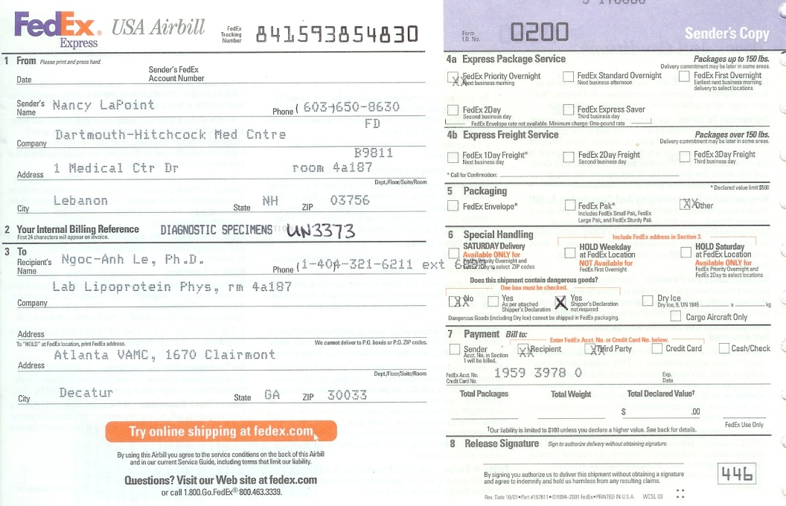
Documentation for Category B (Air waybill)
Air waybill must be marked “Biological Substance, Category B UN3373”
UN1845, Dry Ice, 9
Must include net wt. of Dry Ice
Air waybill must include the text “Dangerous Goods – Shipper’s Declaration not required”
Slide 42
Notes:
List mistakes found:

Slide 43
Material Transfer Agreement (MTA)
A material transfer agreement is a contract between the sender and recipient organizations
Defines the rights and responsibilities of each
Provides a record of the transfer
Issues with sharing materials that may be addressed in a MTA include:
Ability to publish / academic freedom
Ownership of materials to be shared
Ownership of intellectual property
Further distribution of materials
Liability
Slide 43
Notes:
Definition of a Material Transfer Agreement (MTA):

Slide 44
Import, Export, and Biosecurity Regulations
Many countries have import regulations requiring recipients to get a permit prior to importation
Helps expedite clearance of infectious materials through customs
Export controls and export licensing help facilitate legitimate trade and ensure compliance with international treaties
Some countries abide by Australia Group recommendations for export controls
Biological and Toxin Weapons Convention requires State Parties to:
Prevent the transfer of materials which might assist the manufacture, or any means of acquiring biological weapons (Article III)
United Nations Security Council Resolution 1540 requires all States to:
Establish and maintain appropriate effective national export and trans-shipment controls
National biosecurity regulations
Typically require approval of recipient prior to shipment
Slide 44
Notes:
List some key considerations for Import and Export requirements:

Slide 45


What Requires an Import Permit into the US?
Etiologic agents (human pathogens)
Human and animal specimens with a suspected human pathogen
Host & Vectors of human disease
Non-Human Primates
Infectious agents of livestock
Biological materials containing animal material
Tissue culture containing growth stimulants of bovine or other livestock origins
Any animal source material
Slide 45
Notes:
These are some examples of materials that require import permits in the US. Other countries may have similar requirements.
If you are shipping one of these items to the US, who is responsible for obtaining the necessary import permit?

Slide 46
For All Shipments, Consider:
Is an import and/or an export permit needed?
Material transfer agreement or other agreement to share materials prior to shipping?
Documentation indicating recipient is authorized to have material?
Slide 46
Notes:
Questions to consider for all shipments:
Is an import and/or an export permit needed?
Material transfer agreement or other agreement to share materials prior to shipping?
Documentation indicating recipient is authorized to have material?

Slide 47
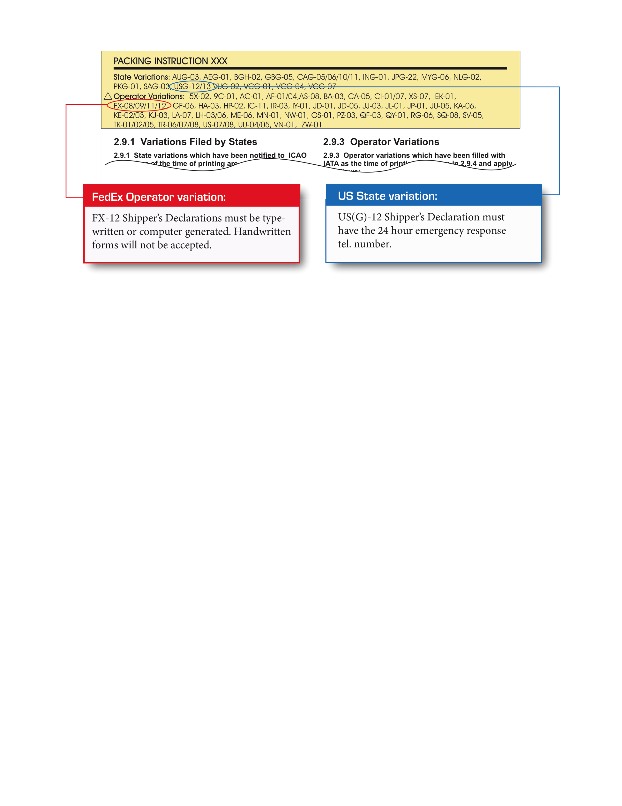
State and Operator Variations
Note: State and operator variations add further restrictions that are applicable only to country or carrier.
Slide 47
Notes:
You may need to research and review with the participants State and Operator variations that may apply to their countries/regions.

Slide 48

Training Requirements
General Awareness/Familiarization
Function Specific
Safety/Security
Record Keeping
Testing
Employer certification
Valid for 2 years
Update when regulations change
Slide 48
Notes:
Training Requirements
General Awareness/Familiarization
Function Specific
Safety/Security
Record Keeping
Testing
Employer certification
Valid for 2 years
Update when regulations change

Slide 49

Security Requirements
DANGEROUS GOODS SECURITY IATA 1.6
Handlers of high consequence DGs should have a security plan. Plan must be based on risk assessment. Basic elements of a security plan
Specific allocation of responsibilities and authorities
Record keeping
Review of current operations and risk assessment
List of mitigation measures (training policies, operating practices, response to higher threat conditions, personnel verification process, access controls, equipment and other resources) to be used to reduce security risks.
Procedures for reporting and dealing with security threats, breaches and incidents
Performance measures and periodic review and update plan
Slide 49
Notes:
List some security requirments:
L
L
L
L
L
L

Slide 50
Elements of Program Management
Training program
Records retention
Written security and safety plans
Emergency response plan
Written policies that ensure:
appropriate approvals and paperwork in place prior to shipping
packages are prepared in such a manner that they arrive at their destination in good condition and present no hazard to persons or animals during transport
Access control (secure storage)
Personnel assurance
Slide 50
Notes:
Record key elements of program management:

Slide 51
Who is Going to Transport it?
Select a carrier that can provide appropriate security
Ensure reliable and trustworthy people handle the package
Control access to transport facilities, docks, and vehicles
Track shipping progress
Provide ongoing security training for employees
Verify that recipient receives package as expected
Email or fax preferred since receipt is documented
Slide 51
Notes:
Key considerations when selecting a carrier:

Slide 52
Facility Responsibilities in Shipping
As discussed at beginning, institution’s need system to:
Ensure appropriate approvals and paperwork in place prior to shipping
Ensure that packages are prepared in such a manner that they arrive at their destination in good condition and present no hazard to persons or animals during transport
Classification, Packaging, Labeling, Marking, Documentation
Control of samples prior to shipping
Which personnel are authorized to have access to the materials and information
Limited access to packages prior to hand over to carrier
E.g secure storage for packages waiting to be picked up by carrier
Using a chain of custody (CoC) may be appropriate for transport of higher security risk materials
Record all individuals who have contact with the dangerous pathogens and toxins up until moment package turned over to carrier
Slide 52
Notes:
Create a chipping checklist:

Slide 53
Facility Responsibilities in Shipping
Selection of an appropriate carrier that can provide appropriate security by
Ensuring reliable and trustworthy people handle the package
Controlling access to transport facilities, docks, and vehicles
Tracking shipping progress
Providing ongoing security training for employees
Verification that recipient receives package as expected
Email or fax preferred since receipt is documented

Slide 54
Program Management
Institution has a range of responsibilities related to the shipment of infectious substances
From approvals prior to shipment through verification that sender receives the shipment
To support those responsibilities, institutions need to have
Appropriate training
Maintenance of records
Written security and safety plans for transport
Based on assessment of transportation safety and security risks
Address personnel, unauthorized access, en route security, training requirements, institutional requirements

Slide 55

Key messages
Before Shipping
Understanding the risks of shipping
Determine the appropriate mitigation measures
Determine the relevant regulations
Shipping Process
Classification of samples
Packaging, marking, and labeling
Documentation
Transfer agreements and permits
Transferring package to carrier
Program Management
Verification of receipt
Incident response
Training
Records
Access controls
Slide 55
Notes:
Record any overview notes and key ideas that you need:

